Slide 1
Software Engineering :
5 : Design : Software Modeling UML - Part 1
Professor Imed Bouchrika National School of Artificial Intelligence imed.bouchrika@ensia.edu.dz

Slide 2
Outline :
Software Design and Modeling
Unified Modeling Language
UML History
Behavioural Diagrams
Use Case Diagram
State Diagram
Activity Diagram
Sequence Diagram

Slide 3
Software Process Models
Software Process :
Software Process Model :

Slide 4
Software Process Models
Code and Fix Model
Plan-Driven / Conventional Methods
Agile Methodologies
No-Code Development Model

Slide 5
Software Development Life Cycle
Ideal Process :
Design and Planning
Implementation
Requirement Analysis
Maintenance
Testing
Integration

Slide 6
After the Requirements Engineering
What’s the next step ?
To code ?
Design ?
What to design ?

Slide 7
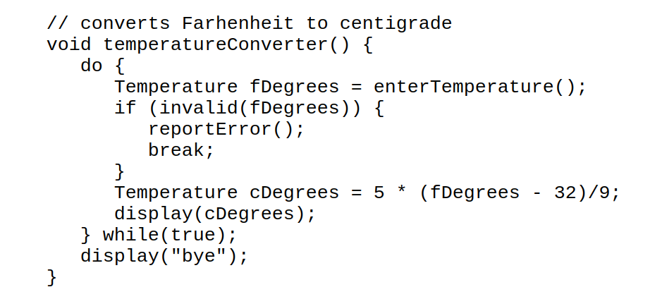
After the Requirements Engineering
What does this code do ?
Can anyone understand the business logic ?
What’s the next step ?
To code ?
Design ?
What to design ?

Slide 8
Modeling and Design
Software Design :
It is a creative process to transform users requirements into visualized form to describe what and how the system will be developed.
a transition from "what" the system must do, to "how" the system will do it
The aim is to produce an implementable solution to a problem.
An iterative process through which a customer’s requirements are translated into a blueprint for constructing the software code.
All design work products must be traceable to the software requirements document (SRS)

Slide 9
Modeling and Design
Software Design :
During the design process, a number of artifacts are produced including:
Conceptual Design (What) : meant for customers
User Interface Designs.
Use-Case Diagrams
Technical Design (How) : meant for developers.
Structural Models
Behavioural Models
Architectural Designs

Slide 10
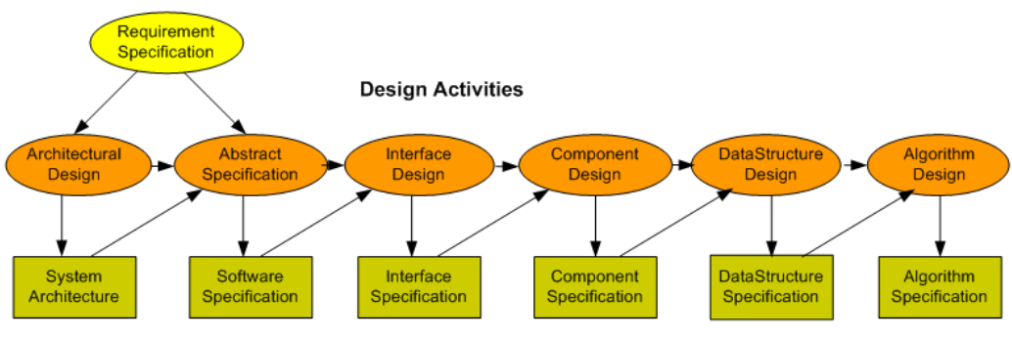
Modeling and Design
Software Design :

Slide 11
Modeling and Design
Software Design :
A major requirement for the design process : that the design must satisfy :
Customers’ needs specified inside the requirements specification
Developers/Implementers based on their expertise in terms of the feasibility of implementation.
Design is not coding, coding is not design
Design is purely a creative task.

Slide 12
Modeling and Design
What’s a System Model
Is an abstraction or simplification of the system to be built based on the requirements being specified.
A model view depicts selected aspects of a model from a perspective of a particular user.
A notation is a set of graphical or textual rules for representing views

Slide 13
Modeling and Design
Why Software Modeling:
Even provided the requirements, we cannot fully comprehend software products when it comes to their functionalities, structures and interactions.
Models can help to :
Clarify and visualize the software to be produced.
To specify the behaviour and structure of the software
Document decisions made for the development phase
Facilitate the communication between differents users.

Slide 14
Modeling and Design
Software Modeling Languages:
Many notations are developed over time
State machines
Entity-relationship diagrams
Dataflow diagrams
..
Most of them are graphical representations with some shapes, lines, arrows…
Why not graphical as opposed to using textual description ?

Slide 15
Modeling and Design
Software Modeling Languages:
Three leading OO notations decided to combine (in the 1990s)
Grady Booch (BOOCH)
Jim Rumbaugh (OMT: Object Modeling Technique)
Ivar Jacobsen (OOSE: OO Soft. Eng)
Why?
Natural evolution towards each other
Effort to set an industry standard for modeling software products

Slide 16
Modeling and Design
Software Modeling Languages:
Three leading OO notations decided to combine (in the 1990s)
Grady Booch (BOOCH)
Jim Rumbaugh (OMT: Object Modeling Technique)
Ivar Jacobsen (OOSE: OO Soft. Eng)
Why?
Natural evolution towards each other
Effort to set an industry standard for modeling software products
Unified Modeling Language

Slide 17

Unified Modeling Language - UML
UML - Unified Modeling Language :
is a general purpose notation that is used to
Visualize
Specify
construct and
Document the artifacts of :
Software-based systems
Business and similar processes,

Slide 18
Unified Modeling Language - UML
Types of UML diagrams :
UML diagrams represent two different views of a system model:
Static (or structural) view: visualize the static structure of the system using objects, attributes, operations and relationships. It includes class diagrams and composite structure diagrams.
Dynamic (or behavioral) view: emphasizes the dynamic behavior of the system by showing collaborations and interactions among objects and changes to the internal states of objects. This view includes sequence diagrams, activity diagrams and state machine diagrams.

Slide 19
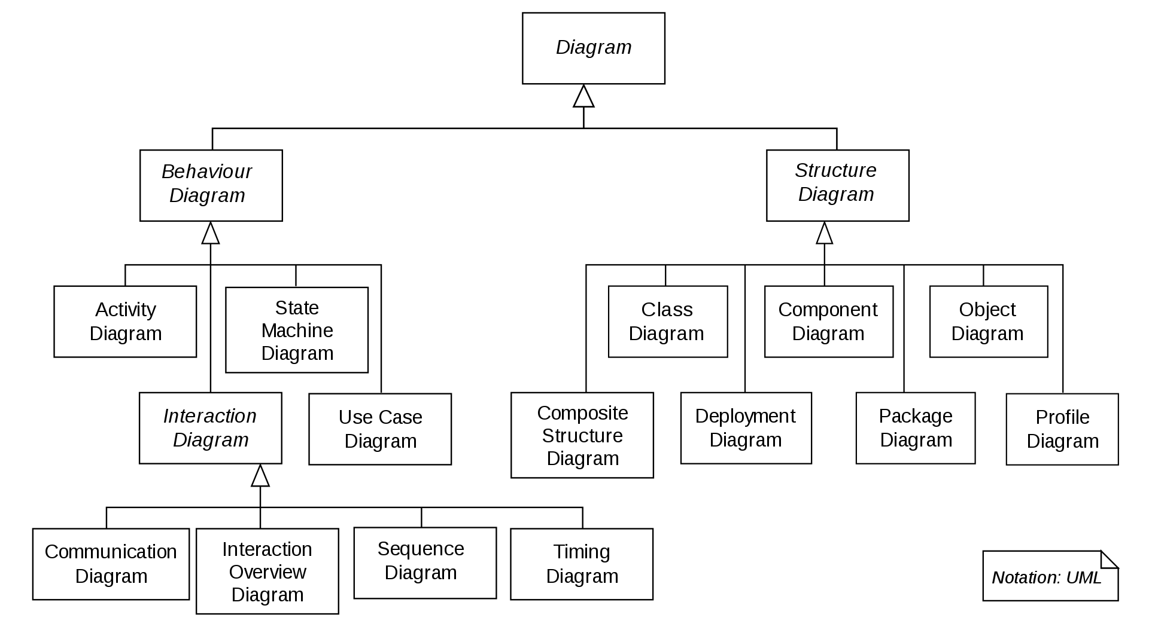
Unified Modeling Language - UML

Slide 20
UML - Behavioral Diagrams - Use Case
Use Case Diagram :
is a graphical depiction of a user's possible interactions with a system.
The user can be an end-user or an external software
It shows the high-level behaviors of the system, user goals and external entities which interact with the system

Slide 21
UML - Behavioral Diagrams - Use Case
Elements of the Use Case Diagram :
Systems
Actors
Use Cases
Relationships

Slide 22
UML - Behavioral Diagrams - Use Case
Elements of the Use Case Diagram :
Systems
Actors
Use Cases
Relationships
Banking Mobile App will be used as a case study

Slide 23
UML - Behavioral Diagrams - Use Case
Elements of the Use Case Diagram :
Systems :
Software product to develop
Website
Mobile App
Software Component…
It is represented as a rectangle with its name at the top

Slide 24
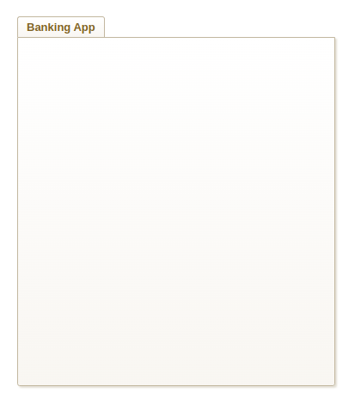
UML - Behavioral Diagrams - Use Case
Elements of the Use Case Diagram :
Systems :
Software product to develop
Website
Mobile App
Software Component…
It is represented as a rectangle with its name at the top (The shown picture, represents a package)

Slide 25
UML - Behavioral Diagrams - Use Case
Elements of the Use Case Diagram :
Actors :
Any entity interacting with the system to achieve a goal
Can be a user, external system, organization or device
Depicted by the Stick Figure

Slide 26
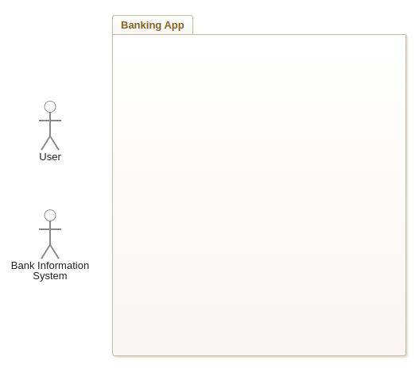
UML - Behavioral Diagrams - Use Case
Elements of the Use Case Diagram :
Actors :
Any entity interacting with the system to achieve a goal
Can be a user, external system, organization or device
Depicted by the Stick Figure

Slide 27
UML - Behavioral Diagrams - Use Case
Elements of the Use Case Diagram :
Actors :
Two types of Actors:
Primary Actors : initiates the use of the system. Placed on the left side
Secondary Actors : are reactionary Actors where the system initiates interaction with them. Placed on the right side.

Slide 28
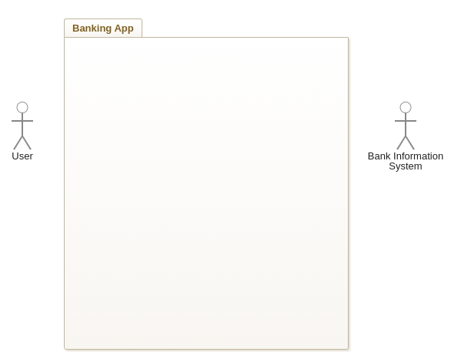
UML - Behavioral Diagrams - Use Case
Elements of the Use Case Diagram :
Actors :
Two types of Actors:
Primary Actors : initiates the use of the system. Placed on the left side
Secondary Actors : are reactionary Actors where the system initiates interaction with them. Placed on the right side.

Slide 29
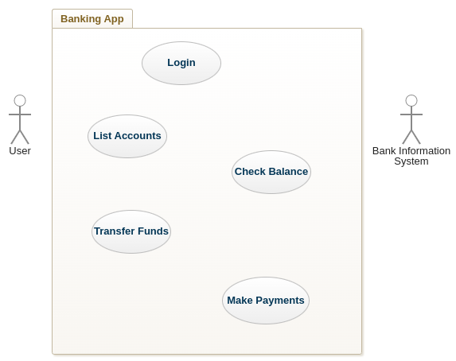
UML - Behavioral Diagrams - Use Case
Elements of the Use Case Diagram :
Use Cases :
Represents a high-level action/feature to be provided by the system.
Depicted by an Oval shape
Each Use Case has a unique label (usually starting with a verb)

Slide 30
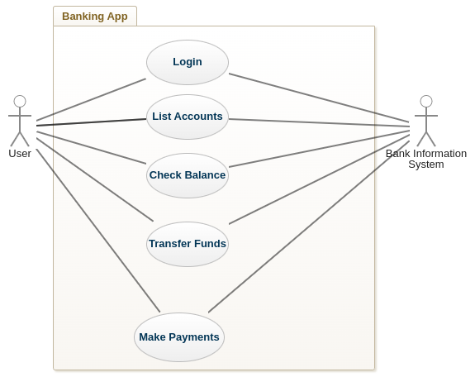
UML - Behavioral Diagrams - Use Case
Elements of the Use Case Diagram :
Relationships :
Association :
it is a relationship between an Actor and User case.
Represented as a solid line.
An Actor can interact or have associations with many uses cases.

Slide 31
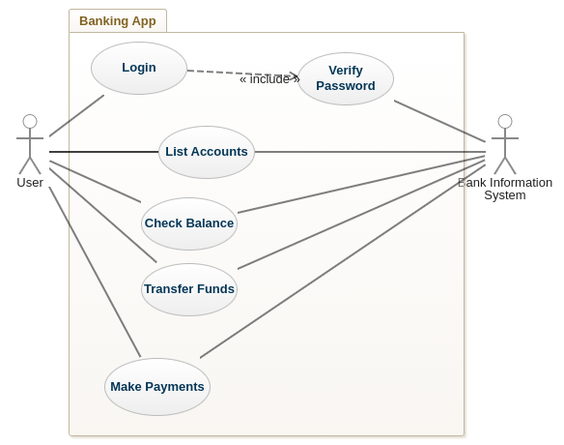
UML - Behavioral Diagrams - Use Case
Elements of the Use Case Diagram :
Relationships :
Include :
It is a relationship between a base use case and another use case that needs to will be done along with the base use case

Slide 32
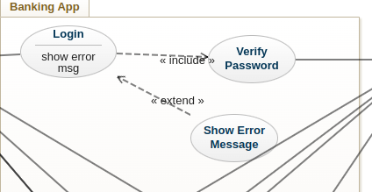
UML - Behavioral Diagrams - Use Case
Elements of the Use Case Diagram :
Relationships :
Extend :
A relationship from a base use case to another case that will be optionally done based on some criteria.

Slide 33
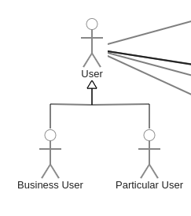
UML - Behavioral Diagrams - Use Case
Elements of the Use Case Diagram :
Relationships :
Generalization :
Called also Inheritance, to show specialized use cases from the general base case.
Depicted by an arrowed line.
Use Cases
Actors

Slide 34
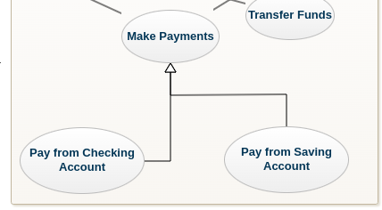
UML - Behavioral Diagrams - Use Case
Elements of the Use Case Diagram :
Relationships :
Generalization :
Called also Inheritance, to show specialized use cases from the general base case.
Depicted by an arrowed line.
Use Cases
Actors

Slide 35
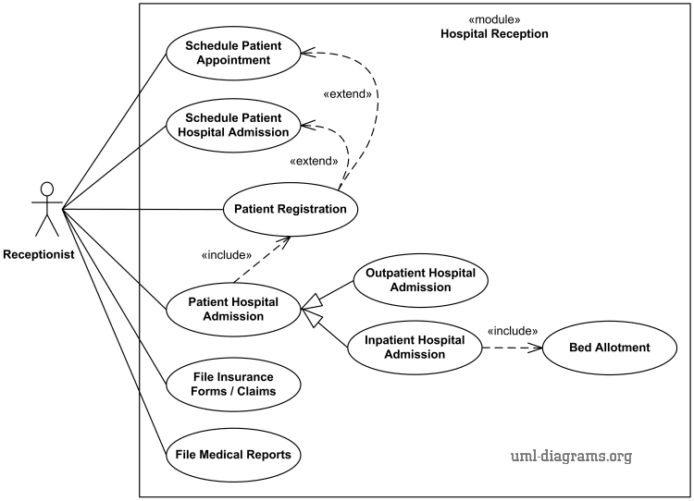
UML - Behavioral Diagrams - Use Case
Examples of the Use Case Diagram :

Slide 36
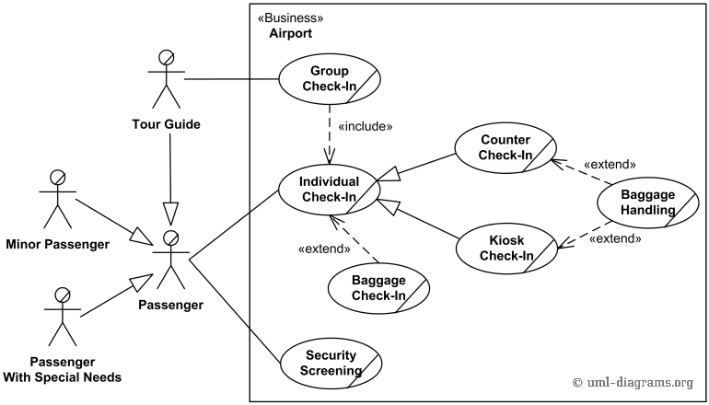
UML - Behavioral Diagrams - Use Case
Examples of the Use Case Diagram :
Use Cases are having an inclined line to indicate that they are business use cases ( not for software systems)

Slide 37
UML - Behavioral Diagrams - State Machine
State Machine Diagram:
is drawn for a single class to show the lifetime behavior of a single object.
It describes all of the possible states that a particular object can get into based on some events/triggers.
State of an object is defined by the value of its attributes and its relationships with other objects at a particular point in time.
Example :
Customer states: New , Pending, Active, Suspended, Inactive
Cheque : Handed, Deposited, Returned, Cashed, Rejected

Slide 38



UML - Behavioral Diagrams - State Machine
State Machine Diagram:
Components
Object Box
States:
Initial
Final/Exit State
State
Transitions
Arrow
Event Label
Other Elements : notes,...
Object name
Event 1
Event 2

Slide 39
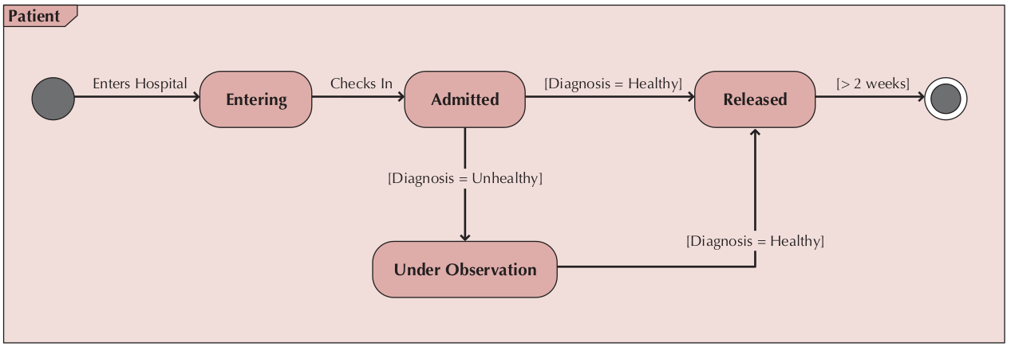
UML - Behavioral Diagrams - State Machine

Slide 40
UML - Behavioral Diagrams - State Machine
Boolean Expression are expressed inside [ ]
Action/Events can be added next to the boolean condition [Condition] ActionName

Slide 41
UML - Behavioral Diagrams - State Machine
State Machine Diagram:
State can be written to include optionally more details about the internal behaviour of the object:
Entry Action
Exit Action
Do Action
State name
entry / receive data A
do / check if data is valid
exit / inform the user

Slide 42
UML - Behavioral Diagrams - State Machine
State Machine Diagram:
State can :
Include sub-states
Include Regions (Or Forking can be used)
State name
State A
do / some action
State B
do / some action

Slide 43
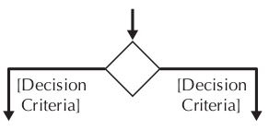
UML - Behavioral Diagrams - State Machine
State Machine Diagram:
A decision node (Diamond Shape) can used for branching from a single state to multiple states.

Slide 44
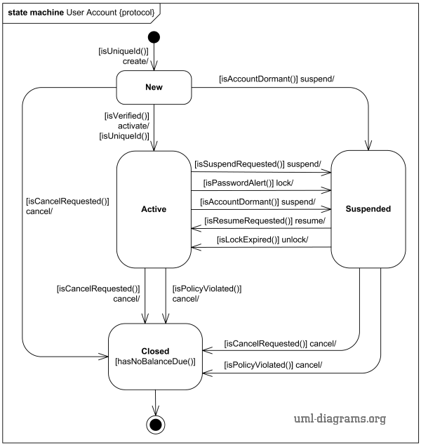
UML - Behavioral Diagrams - State Machine

Slide 45
UML - Behavioral Diagrams - Activity
Activity Diagram:
It is like the state machine diagram but with more control features including iteration, concurrency and choice.
Instead of capturing the behavior of an object state
Used to model the behavior of a system, component or even algorithm
Used to represent to flow of control from one activity to another activity for processes and procedures/algorithms

Slide 46


UML - Behavioral Diagrams - Activity
Activity Diagram:
Components
Activity (set of action ) and Actions ( non-decomposable)
Object Node : To represent data/object
Transitions
Solid Line : Transition from activity to another activity
Dashed Line : Transition
Swimlines : Used to contain activities related to a specific actor

Slide 47



UML - Behavioral Diagrams - Activity
Activity Diagram:
Components : nodes
Nodes:
Initial :
Final-Flow : Is used to stop a specific control flow or object flow
Final-Activity : Is used to stop all control flows and object flows in an activity

Slide 48
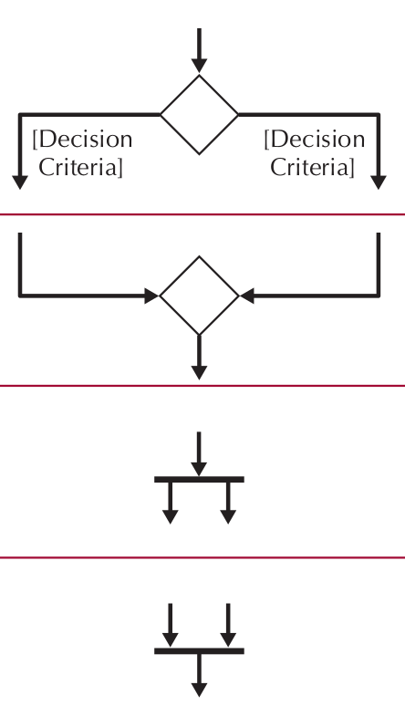
UML - Behavioral Diagrams - Activity
Activity Diagram:
Components : nodes
Nodes:
Decision : used for branching the flow based on some condition, it is not restricted to binary branching.
Merge : Used to bring different flows from a decision node
Fork : Used to split the behavior into a set of parallel flows of activities.
Join : Used to bring back parallel flows

Slide 49
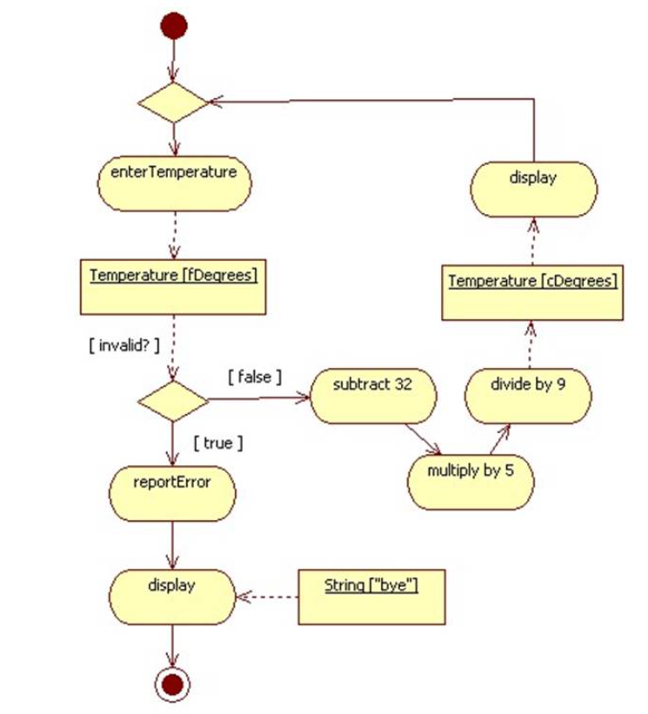
UML - Behavioral Diagrams - Activity

Slide 50
UML - Behavioral Diagrams - Activity

Slide 51
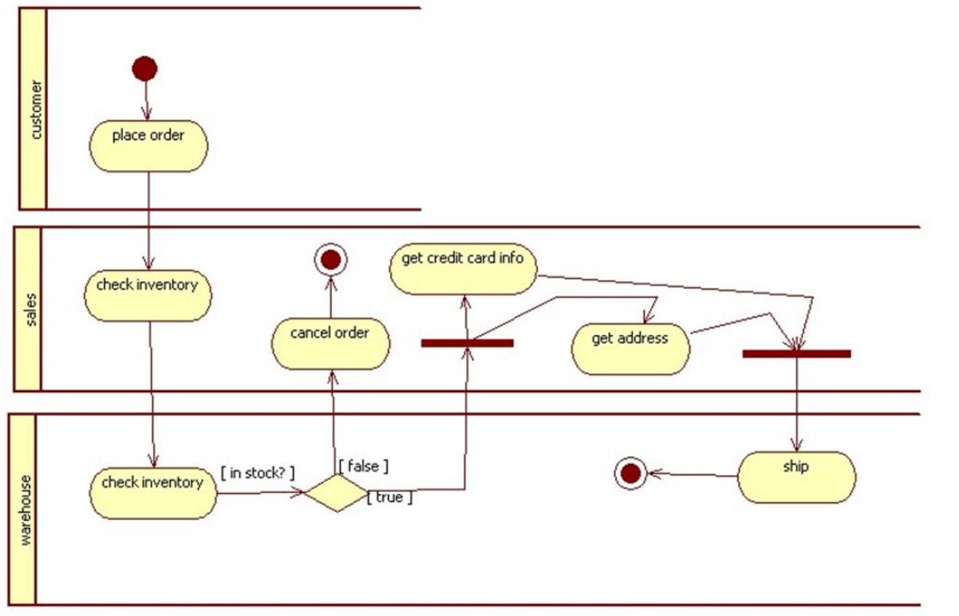
UML - Behavioral Diagrams - Activity
Activity Diagram:
Example for three swimlines where each swimline corresponds to a different actor

Slide 52
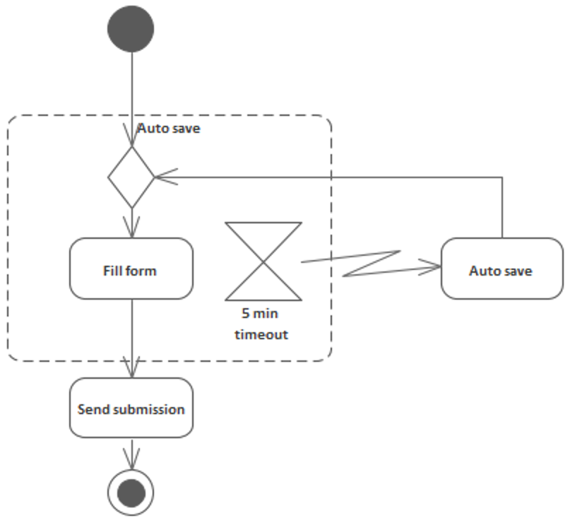
UML - Behavioral Diagrams - Activity
Activity Diagram:
Example for :
Zig-zag line to show an interrupt flow from an activity in a flow to another activity
Timer/Clock ( Can represent a background or cron process)

Slide 53
UML - Behavioral Diagrams - Sequence
Sequence Diagram:
It is an interactional diagram depicting the communication and interaction between different entities over their lifespan
Entities:
Actors
Objects/Classes

Slide 54
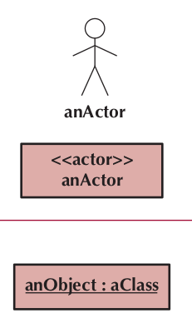
UML - Behavioral Diagrams - Sequence
Sequence Diagram:
Components:
Entities : Placed at the top of the diagram
Actor : is a person or an external system using or being by used by the system. Depicted as the stick figure for human, if nonhuman is involved, use the rectangle notation
Object : it participates in the sequence by sending/receiving messages

Slide 55
UML - Behavioral Diagrams - Sequence
Sequence Diagram:
Components:
Lifespan :
Dashed Line : Denotes the life of an object during a sequence
Execution Box : Denotes when an object is executing some business logic whilst sending or receiving messages
Object Destruction : An X is placed at the end of an object’s lifeline to show that it is going out of existence.
ObjectName

Slide 56
UML - Behavioral Diagrams - Sequence
Sequence Diagram:
Components:
Synchronous Messages or Methods:
Are represented as a solid line arrow (filled head) between the two entities.
A label for the method is written at the top of the arrow.
The sender needs to wait for the receiver until it completes the execution
Asynchronous Messages :
The caller does not wait for the receiver to process the message. Represented as a solid line arrow (Non-filled head) .
Return Messages :
Dashed arrow indicates the return message
Reflexive Message :
When an object calls itself
ObjectName
VerifyPIN()
VerifyResult
SendData()

Slide 57
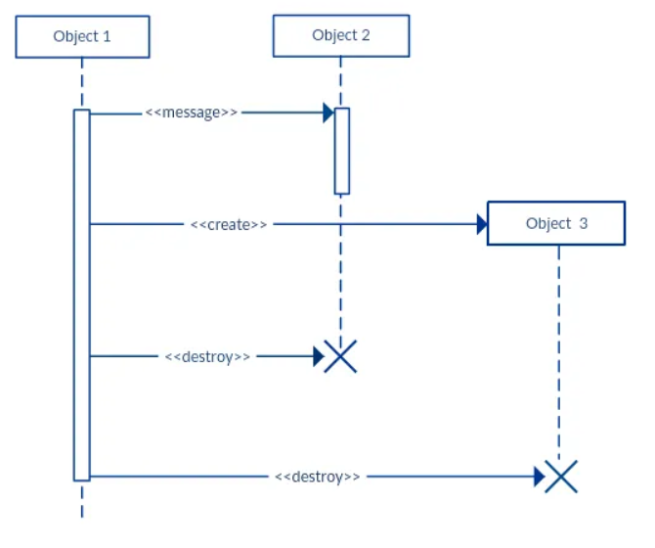
UML - Behavioral Diagrams - Sequence
Sequence Diagram:
Note that Objects do not need to created at the same time where all of their lifespans start from the top section.
They can be created by other entities.

Slide 58
UML - Behavioral Diagrams - Sequence
Sequence Diagram:
Components:
Frames
Can be used for more advanced control including Loops or decision
ObjectName
Loop
addItem()
GetTotal()
CartTotal

Slide 59
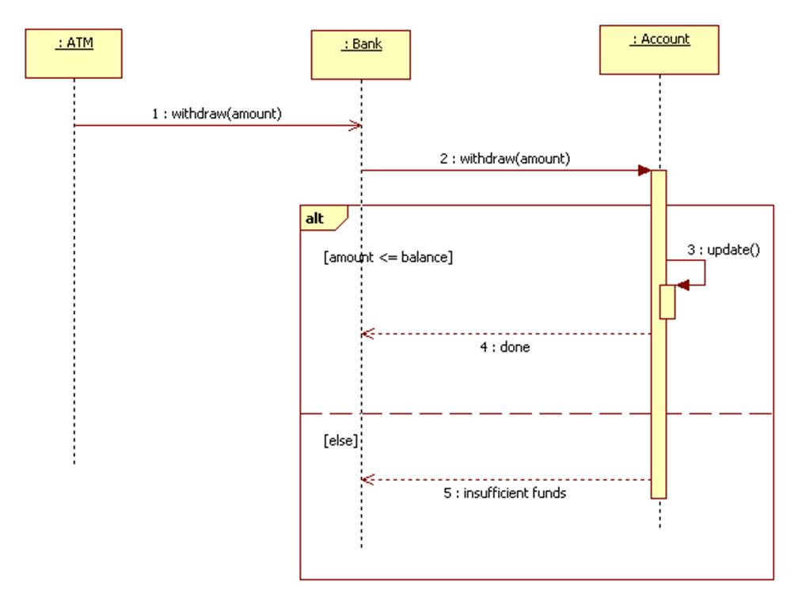
UML - Behavioral Diagrams - Sequence
Sequence Diagram: Example for decision using ALT
It is better to write the sequence number : 1, 2,3 ..

